Slide 1
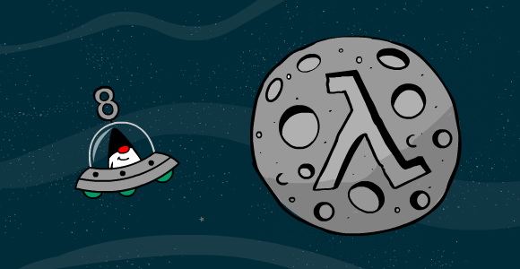
Functional Programming in Java Lambda Expressions

Slide 2

Agenda
Lambda Expressions : Why
Lambda Expressions : What
Lambda Expressions : How

Slide 3

Let’s start with some Pizza

Slide 4
Someone needs our help
Suppose there’s a Pizza shop which offers two types of Pizza, Chicken and Beef
Price of each Pizza ranges in between 500 and 1000.
They have a menu, which is a list of Pizza and they need our help to let customers query on that list.
And they provided us only one API to get the list.

Slide 5
The Pizza Class
public class Pizza {
private final int price;
private final String type;
public Pizza(String type, int price){
this.type = type;
this.price = price;
}
public Integer getPrice() {
return price;
}
public String getType() {
return type;
}
}

Slide 6

Yes we know ..
The design of the Pizza class is horrible but sadly we can’t do anything with that.

Slide 7
The List
List<Pizza> menu = Arrays.asList(
new Pizza("Chicken", 500),
new Pizza("Chicken", 600),
new Pizza("Chicken", 800),
new Pizza("Beef", 900),
new Pizza("Beef", 700),
new Pizza("Beef", 1000)
);

Slide 8

Query 1
Can we get some Chicken Pizza?

Slide 9

public static List<Pizza> getAllPizzaByType(
List<Pizza> menu, String type) {
List<Pizza> result = new ArrayList<>();
for (Pizza pizza : menu) {
if (type.equals(pizza.getType())) {
result.add(pizza);
}
}
return result;
}
getAllPizzaByType(menu, ”Chicken”);
getAllPizzaByType(menu, ”Beef”);

Slide 10

Query 2
Can we know which pizza cost less then 700 bucks?

Slide 11
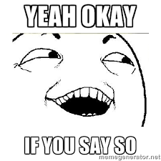
public static List<Pizza> getAllPizzaByPrice(
List<Pizza> menu, int price) {
List<Pizza> result = new ArrayList<>();
for (Pizza pizza : menu) {
if (pizza.getPrice() < price) {
result.add(pizza);
}
}
return result;
}
getAllPizzaByPrice(menu, 700);

Slide 12

But ..

Slide 13
Our two Methods
public static List<Pizza> getAllPizzaByType(
List<Pizza> menu, String type) {
List<Pizza> result = new ArrayList<>();
for (Pizza pizza : menu) {
if (type.equals(pizza.getType())) {
result.add(pizza);
}
}
return result;
}
public static List<Pizza> getAllPizzaByPrice(
List<Pizza> menu, int price) {
List<Pizza> result = new ArrayList<>();
for (Pizza pizza : menu) {
if (pizza.getPrice() < price) {
result.add(pizza);
}
}
return result;
}

Slide 14
Are we doing it right?
public static List<Pizza> getAllPizzaByType(
List<Pizza> menu, String type) {
List<Pizza> result = new ArrayList<>();
for (Pizza pizza : menu) {
if (type.equals(pizza.getType())) {
result.add(pizza);
}
}
return result;
}
public static List<Pizza> getAllPizzaByPrice(
List<Pizza> menu, int price) {
List<Pizza> result = new ArrayList<>();
for (Pizza pizza : menu) {
if (pizza.getPrice() < price) {
result.add(pizza);
}
}
return result;
}

Slide 15

Meanwhile : Query 3
Can we get only Beef pizza which cost less than 700 bucks?

Slide 16
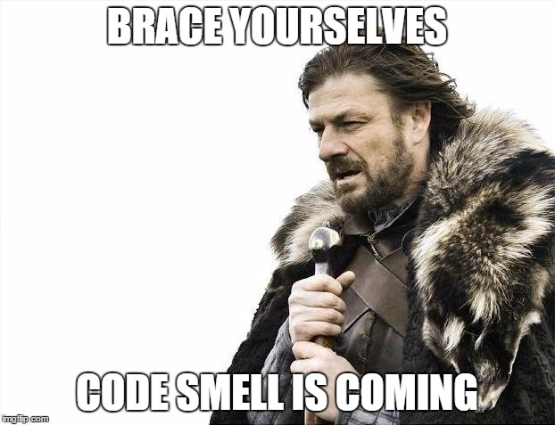

Slide 17
public static List<Pizza> getAllPizzaByTypeAndPrice(
List<Pizza> menu, String type, int price) {
List<Pizza> result = new ArrayList<>();
for (Pizza pizza : menu) {
if (type != null && price != 0) {
if (type.equals(pizza.getType()) && pizza.getPrice() < price) {
result.add(pizza);
}
}
else if (type != null) {
if (type.equals(pizza.getType())) {
result.add(pizza);
}
}
else if (price != 0) {
if (pizza.getPrice() < price) {
result.add(pizza);
}
}
else {
System.err.println("Returning Empty List");
}
}
return result;
}
getAllPizzaByTypeAndPrice(menu, "Beef", 700);
getAllPizzaByTypeAndPrice(menu, null, 700);
getAllPizzaByTypeAndPrice(menu, "Chicken", 0);

Slide 18

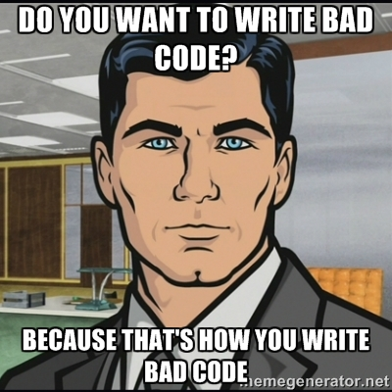

Slide 19

Can we do it any better?
From a List of Pizza
Filter Pizza by Price
Filter Pizza by Type
Filter Pizza by both Price and Type

Slide 20
Let’s try another way
<< interface >>
PizzaPredicate
+ boolean test(Pizza pizza)
TypePredicate
TypeAndPricePredicate
PricePredicate

Slide 21
Predicates
public interface PizzaPredicate {
boolean test(Pizza pizza);
}
public class PizzaPricePredicate implements PizzaPredicate {
private final int price;
public PizzaPricePredicate(int price) {
this.price = price;
}
@Override
public boolean test(Pizza pizza) {
return pizza.getPrice() < price;
}
}
public class PizzaTypePredicate implements PizzaPredicate {
private final String type;
public PizzaTypePredicate(String type) {
this.type = type;
}
@Override
public boolean test(Pizza pizza) {
return type.equals(pizza.getType());
}
}

Slide 22
More of Predicates
public class PizzaTypeAndPricePredicate implements PizzaPredicate { private final String type;
private final int price;
public PizzaTypeAndPricePredicate(String type, int price) {
this.type = type;
this.price = price;
}
@Override
public boolean test(Pizza pizza) {
return type.equals(pizza.getType()) && pizza.getPrice() < price;
}
}

Slide 23
New API Using Behavior Parameterization
public static List<Pizza> filterPizza(
List<Pizza> menu, PizzaPredicate predicate) {
List<Pizza> result = new ArrayList<>();
for (Pizza pizza : menu) {
if (predicate.test(pizza)) {
result.add(pizza);
}
}
return result;
}
filterPizza(menu, new PizzaPricePredicate(700));
filterPizza(menu, new PizzaTypePredicate("Checken"));
filterPizza(menu, new PizzaTypeAndPricePredicate("Beef", 700));

Slide 24
So?
What have we achieved?
The behavior of the filterPizza method depends on the code we pass to it via the PizzaPredicate object, not on any specific value.
But?
The only code that really matters is the implementation of the test method, this is what defines the new behaviors for the filterPizza method.
Unfortunately, because the filterPizza method can only take objects, we have to wrap that code inside an PizzaPredicate object.
What we’re doing is similar to “passing code” inline, because we’re passing a boolean expression through an object that implements test method.

Slide 25
Verbosity
We’re forced to declare several classes that implement the PizzaPredicate interface and then instantiate several PizzaPredicate objects that we allocate only once.
The process is verbose because we need to declare multiple classes that we instantiate only once.
Verbosity
- noun
A quality possessed by people who talk a lot while saying very little at all.
An expressive style that uses excessive or empty words.

Slide 26

Tackling Verbosity

Slide 27
Anonymous Classes
filterPizza(menu, new PizzaPredicate() {
@Override
public boolean test(Pizza pizza) {
return pizza.getPrice() < 700;
}
});
filterPizza(menu, new PizzaPredicate() {
@Override
public boolean test(Pizza pizza) {
return "Chicken".equals(pizza.getType());
}
});
filterPizza(menu, new PizzaPredicate() {
@Override
public boolean test(Pizza pizza) {
return "Beef".equals(pizza.getType())
&& pizza.getPrice() < 700 ;
}
});

Slide 28
Anonymous Classes
button.setOnAction(new EventHandler<ActionEvent>() {
public void handle(ActionEvent event) {
System.out.println("Woooo a click!!");
}
});
Anonymous classes are like local classes (a class defined in a block) which don’t have a name.
They allow us to declare and instantiate a class at the same time. In other words, they allow us to create ad hoc implementations.
Anonymous classes somewhat tackle the verbosity associated with declaring multiple concrete classes for an interface, but they’re still unsatisfactory.
In the context of passing a simple piece of code (for example, a boolean expression representing a selection criterion), we still have to create an object and explicitly implement a method to define a new behavior (for example, the method test for Predicate or the method handle for EventHandler).

Slide 29
Better, but still ..
filterPizza(menu, new PizzaPredicate() {
@Override
public boolean test(Pizza pizza) {
return pizza.getPrice() < 700;
}
});
filterPizza(menu, new PizzaPredicate() {
@Override
public boolean test(Pizza pizza) {
return "Chicken".equals(pizza.getType());
}
});
filterPizza(menu, new PizzaPredicate() {
@Override
public boolean test(Pizza pizza) {
return "Beef".equals(pizza.getType())
&& pizza.getPrice() < 700 ;
}
});

Slide 30
How can we get rid of Verbosity?
All we need is to test if the pizza meets a specific criteria.
Writing concrete classes seems like an overkill for such use case.
Anonymous classes are better but still lots of boilerplate codes.

Slide 31
Oh wait, isn’t this supposed to be a session on Lambda Expressions?

Slide 32
Sorry, my bad ..
Filter Pizza by Price
filterPizza(menu, (Pizza p) -> p.getPrice() < 700);
Filter Pizza by Type
filterPizza(menu, (Pizza p) -> "Chicken".equals(p.getType()));
Filter Pizza by both Price and Type
filterPizza(menu, (Pizza p) -> p.getPrice() < 700 &&
"Beef".equals(p.getType()));

Slide 33
Yes, that’s it !!
public interface PizzaPredicate {
boolean test(Pizza pizza);
}
public static List<Pizza> filterPizza(List<Pizza> menu, PizzaPredicate predicate) {
List<Pizza> result = new ArrayList<>();
for (Pizza pizza : menu) {
if (predicate.test(pizza)) {
result.add(pizza);
}
}
return result;
}
Filter Pizza by Price
filterPizza(menu, (Pizza p) -> p.getPrice() < 700);
Filter Pizza by Type
filterPizza(menu, (Pizza p) -> "Chicken".equals(p.getType()));
Filter Pizza by both Price and Type
filterPizza(menu, (Pizza p) -> p.getPrice() < 700 &&
"Beef".equals(p.getType()));

Slide 34
Lambda Expression : What?
A lambda expression can be understood as a concise representation of an anonymous function that can be passed around: it doesn’t have a name, but it has a list of parameters, a body, a return type, and also possibly a list of exceptions that can be thrown.
Anonymous — We say anonymous because it doesn’t have an explicit name like a method would normally have. So less to write and think about!
Function— We say function because a lambda isn’t associated with a particular class like a method is. But like a method, a lambda has a list of parameters, a body, a return type, and a possible list of exceptions that can be thrown.
Passed around— A lambda expression can be passed as argument to a method or stored in a variable.
Concise— We don’t need to write a lot of boilerplate like we do for anonymous classes.

Slide 35
Cool, but why should we care?
Let’s look at all of our implementations
filterPizza(menu, new PizzaPricePredicate(700));
filterPizza(menu, new PizzaTypePredicate("Chicken"));
filterPizza(menu, new PizzaTypeAndPricePredicate("Beef", 700));
filterPizza(menu, new PizzaPredicate() {
@Override
public boolean test(Pizza pizza) {
return pizza.getPrice() < 700;
}
});
filterPizza(menu, new PizzaPredicate() {
@Override
public boolean test(Pizza pizza) {
return "Chicken".equals(pizza.getType());
}
});
filterPizza(menu, new PizzaPredicate() {
@Override
public boolean test(Pizza pizza) {
return "Beef".equals(pizza.getType()) && pizza.getPrice() < 700;
} }
);
filterPizza(menu, (Pizza p) -> p.getPrice() < 700);
filterPizza(menu, (Pizza p) -> "Chicken".equals(p.getType()));
filterPizza(menu, (Pizza p) -> p.getPrice() < 700 && "Beef".equals(p.getType()));

Slide 36
Cool, but why should we care?
We saw in previous discussions that passing code is currently tedious and verbose in Java. Lambdas fix this problem: they let us pass code in a concise way.
Lambdas technically don’t let us do anything that we couldn’t do prior to Java 8. But we no longer have to write clumsy code using anonymous classes to benefit from behavior parameterization!
The net result is that code will be clearer and more flexible. For example, using a lambda expression we can create a custom Comparator object in a more concise way.
Before
Comparator<Apple> byWeight = new Comparator<Apple>() {
public int compare(Apple a1, Apple a2){
return a1.getWeight().compareTo(a2.getWeight());
}
};
After
Comparator<Apple> byWeight =
(Apple a1, Apple a2) -> a1.getWeight().compareTo(a2.getWeight());

Slide 37
Lambda Expression : Composition
Arrow
(Apple a1, Apple a2) -> a1.getWeight().compareTo(a2.getWeight());
Lambda Parameters
Lambda Body
A list of parameters : In this case it mirrors the parameters of the compare method of a Comparator, two Apples.
An arrow : The arrow (->) separates the list of parameters from the body of the lambda.
The body of the lambda : Compare two Apples using their weights. The expression is considered the lambda’s return value.
( parameters ) -> expression
( parameters ) -> { statement; }

Slide 38
Lambda Expression : Syntax
Which are valid?
() -> {}
() -> “Rony"
() -> {return “Mama";}
(Integer i) -> return “Tahmid" + i;
(String s) -> {“Rezwan Bhai";}
( parameters ) -> expression
( parameters ) -> { statement; }

Slide 39
Lambda Expression : Syntax
Which are valid?
() -> {}
() -> “Rony"
() -> {return “Mama";}
(Integer i) -> return “Tahmid" + i; { return “Tahmid" + i; }
(String s) -> {“Rezwan Bhai";} (String s) -> “Rezwan Bhai"
( parameters ) -> expression
( parameters ) -> { statement; }

Slide 40
Lambda Expression : Example
Use Cases | Examples of Lambda
A boolean Expression | ( List<String> list ) -> list.isEmpty()
Creating Objects | () -> new Apple(10)
Consuming from an Object | (Apple a) -> { System.out.println (a.getWeight()); }
Select/Extract from an Object | (String s) -> s.length()
Combine two values | (int a, int b) -> a * b
Comparing two objects | (Apple a1, Apple a2) -> a1.getWeight().compareTo(a2.getWeight())

Slide 41

Lambda Expression : How
Lambda expression can be used in the context of a functional interface.

Slide 42
Functional Interface
Lambda expression can be used in the context of a functional interface.
A functional interface is an interface that specifies exactly one abstract method.
public interface PizzaPredicate {
boolean test(Pizza pizza);
}
PizzaPredicate predicate =
Pizza p -> p.getPrice < 700
public interface Runnable {
void run();
}
Runnable r = () -> {};
public interface Callable <V> {
V call();
}
Callable<Mama> callable =
() -> new Mama("Nadim bhai");
public interface Comparator<T> {
int compare(T o1, T o2);
}
Comparator<Pizza> comparator =
(Pizza p1, Pizza p2) ->
p1.getPrice().compareTo(u2.id))

Slide 43
Lambda Expression : When & How
Lambda expressions let us provide the implementation of the abstract method of a functional interface directly inline and treat the whole expression as an instance of a functional interface.
We can achieve the same thing with an anonymous inner class, although it’s clumsier.
The following code is valid because Runnable is a functional interface
defined by only one abstract method
Runnable r1 = () -> System.out.println(“Running r1");
Runnable r2 = new Runnable() {
@Override public void run() {
System.out.println(“Running r2");
}
};
public static void process(Runnable r) {
r.run();
}
process(r1);
process(r2);
process(() -> System.out.println(“Running r3"));

Slide 44
Let’s Recap : Agenda
Lambda Expressions
Why?
To make our code concise, more readable and less verbose.
What?
Just a like a regular method but without any name (an anonymous function).
How?
By providing the implementation of the abstract method of a functional interface directly inline.

Slide 45
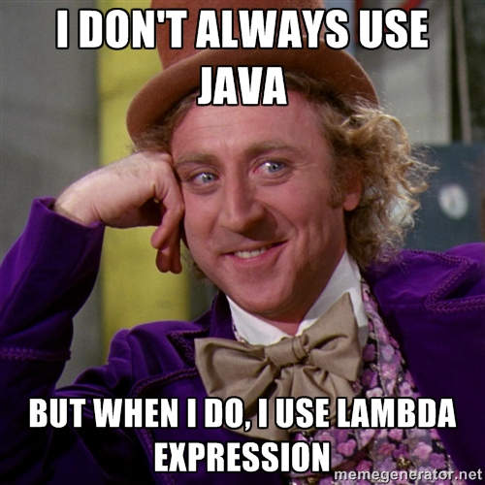
That’s it!

Slide 46

Reference 1. Java 8 in action, Raoul-Gabriel Urma, Mario Fusco, and Alan Mycroft
https://www.manning.com/books/java-8-in-action

